Slide 1
Employers/Individuals and Personal Support Workers (PSWs) Transition to Oregon’s new Financial Management Agent Services (FMAS)
Filling out necessary paperwork
December 2016

Slide 2
List of forms sent to Employers and Employees/Personal Support Workers (PSWs)
All of these listed forms (except optional Responsible Party Form) must be completely filled out and submitted in order for PSWs to be paid.
Employee (PSW) forms require signatures from both the Employer and PSW.
Employers | Signatures
IRS SS-4 Application for Employer Identification Number **for new Employers only. TNT Transition Employers don’t need this form. | Employer only
2. IRS Form 2678 Employer/Payer of Agent | Employer only
3. OR Form 150-800-005 Tax Information Authorization & POA Rep | Employer only
4. Responsible Party Form (optional) | Employer only
Employees (PSWs)
1. Provider Information and Attestation Form | BOTH
2. I-9 Employment Eligibility Verification | BOTH
3. W-4 | Employees (PSWs) only

Slide 3
When can you begin work?
The Answer: IT DEPENDS
The ability to begin providing services as a Personal Support Worker rely on a variety of factors. Completing the enrollment paperwork with PCG Public Partnerships is just one piece. PSWs must also have (from ODDS):
1. A Completed Provider Enrollment Application and Agreement
2. A Criminal Background Check
3. A Signed and Active Job Description for the Person Being Served
For more information about the status of these other requirements contact the Brokerage or CDDP you are working with.
NOTE: Timesheets will continue to be managed by eXPRS. This process is not changing and is not covered by Public Partnerships. For more information regarding eXPRS, please check with your Brokerage or CDDP you are working with.

Slide 4
EMPLOYER FORMS
These forms must be submitted in order for their associated PSWs to be paid.
  IRS Form 2678 Employer/Payer of Agent
  OR Form 150-800-005 Tax Information Authorization & POA Rep
  IRS SS-4 Application for Employer Identification Number
    **for new Employers only. TNT Transition Employers don’t need this form.
  OPTIONAL: Responsible Party Form

Slide 5
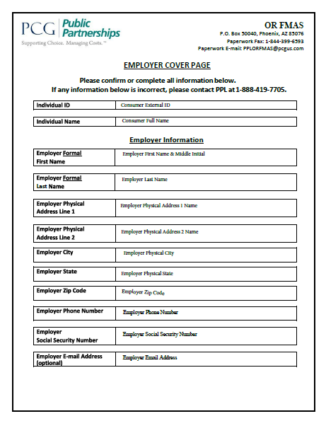
EMPLOYERS: Confirm information in Enrollment Packets
If any information is incorrect:
Employers will need to contact PPL’s customer service to receive a new Enrollment Packet.
Toll-free number – English 1-888-419-7705
Toll-free number – Spanish 1-888-419-7720
Toll-free number – Russian 1-888-419-7734
TTY free number 1-800-360-5899

Slide 6
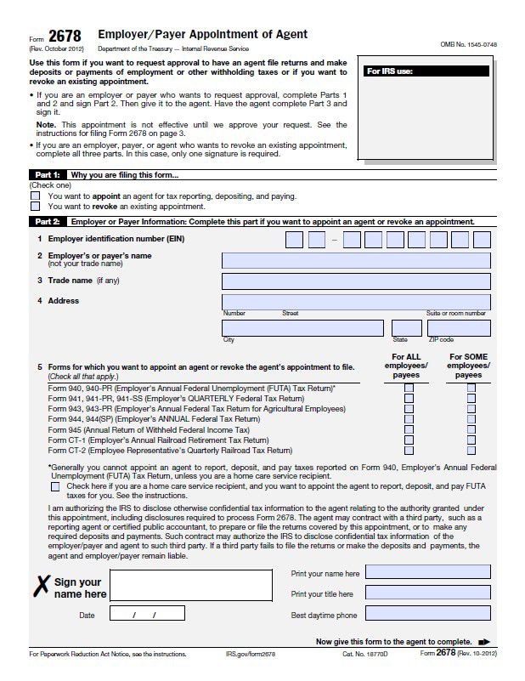
EMPLOYERS: Required form #1
IRS Form 2678 Employer/Payer Appointment of Agent
# of pages: 1
Who needs to sign?: Employer only
What am I signing?: This form tells the IRS that the Employer is giving PPL permission to complete tax processes on their behalf for this program. This form only allows us to withhold taxes from the PSW’s paychecks and deposit those taxes with the IRS. It does not allow PPL access to any personal income tax information.
Where do I sign? PPL will put the Employers information into this form. They only need to sign and date where highlighted in yellow.

Slide 7
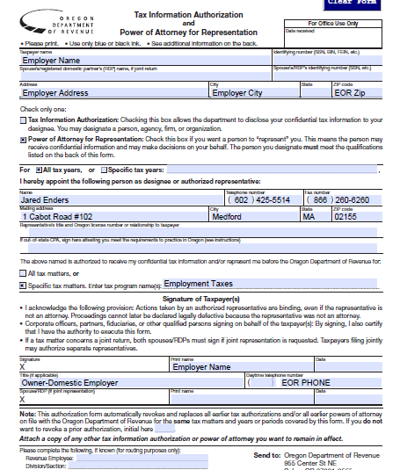
EMPLOYERS: Required form #2
OR Form 150-800-005 Tax Information Authorization & Power of Attorney Representation
# of pages: 1
Who needs to sign?: Employer only
What am I signing?: This state form will authorize PPL to perform withholding and other tax preparations/ filing functions on behalf of the Employer at the state level.
Where do I sign? PPL will put the Employer’s information into this form. They only need to sign and date where highlighted in yellow.

Slide 8
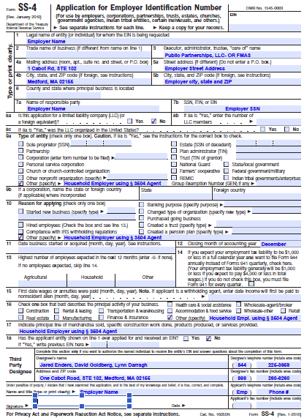
EMPLOYERS: Required form (for New Employers only)
IRS Form 22-4 Application for Employer Identification Number
# of pages: 1
Who needs to sign?: Employer only
What am I signing?: This form is an Application to the IRS for receiving an Employer Identification number.
Where do I sign? PPL put the Employers information into this form. Employers only need to sign and date where highlighted in yellow.

Slide 9
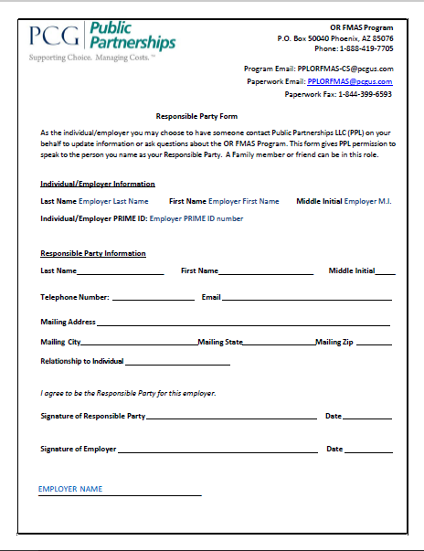
EMPLOYERS: Optional form
Responsible Party Form
# of pages: 1
Who needs to sign?: Employer and responsible party
What am I signing?: This form gives PPL permission to speak to someone other than the Employer. An employer may want a friend or family member to be able to contact PPL with questions or to update the employer’s information. Without this form on file, PPL may only give case-specific information to the Employer themselves.
Where do I sign? The responsible party and employer fills out the form, and signs and dates as specified on form.

Slide 10
PSW FORMS
Both PSW and Employer signatures and dates are required on 2 of the 3 forms in order for the associated PSWs to be paid.
  Provider Information and Attestation Form (BOTH)
  I-9 Employment Eligibility Verification (BOTH)
  W-4 (PSW only)

Slide 11
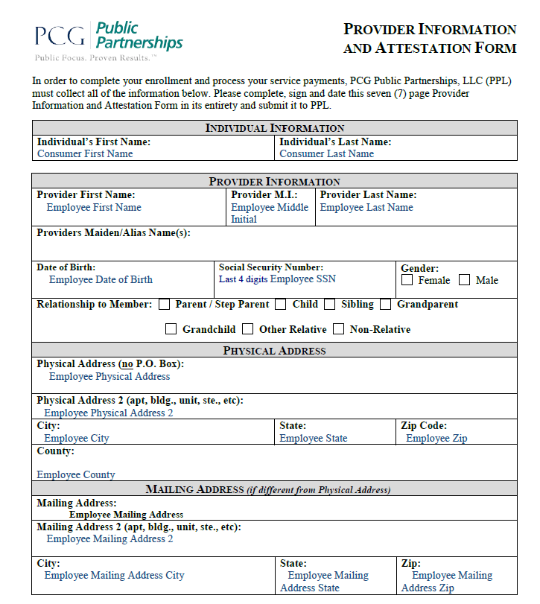
PSW: Required form #1
Provider Information and Attestation Form
# of pages: 7
Who needs to sign?: Both PSW and Employer must sign on page 7.
PPL uses this form to update our BetterOnline system with relevant Provider (PSW) information, including:
Page 1-2: PSW contact information. Please check ‘Gender’ and ‘Relationship to Member’ and confirm information printed on the form is correct.
Page 3: Application for “Difficulty of Care” Federal Income Tax Exclusion
Page 4: How the PSW wants to be paid
Page 5: ‘Relationship Questionnaire’ which is used for determining proper tax withholdings. Check each box as appropriate.
Page 6-7: Employment Agreement which communicates responsibilities of a PSW in this program.

Slide 12
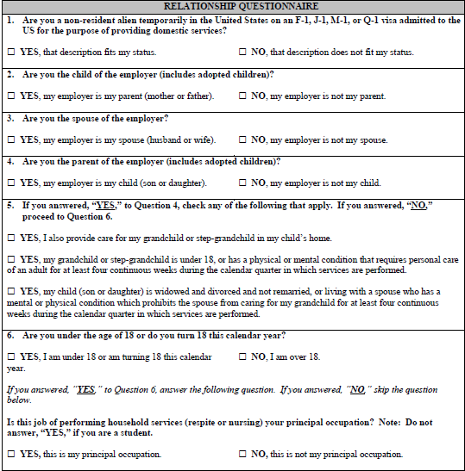
PSW: Provider Information and Attestation Form
Relationship Questionnaire:
On page 5 of the Provider Information and Attestation Form, this questionnaire helps determine the PSW’s relationship to the Individual being serviced so we may properly withhold PSWs taxes and determine if eligible for exemption of FICA/FUTA withholdings.
Check off the Yes/No boxes as appropriate.
NOTE: The relationship questions #2-4 should be based on the Individual the PSW provides services to – (not the “employer” if this is different person than the Individual).

Slide 13
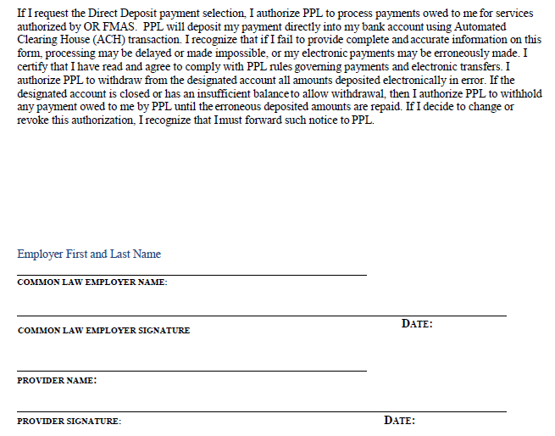
PSW: Provider Information and Attestation Form
Page 6 and 7 is the Employment Agreement and must be signed and dated by both the Employer and Personal Support Worker (Provider).

Slide 14
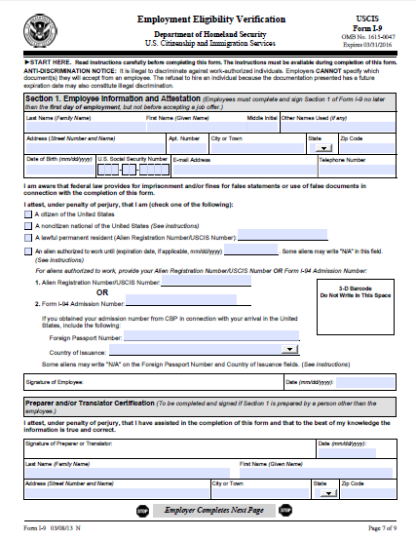
PSW: Required form #2
Form I-9 Employment Eligibility Verification
# of pages: 2
Who needs to sign?: Both the Employer and PSW.
What am I signing?: The Employment Eligibility Verification Form I-9 is a U.S. Citizenship and Immigration Services form. It is used by an employer to verify an employee's identity and to establish that the worker is eligible to accept employment in the United States.
PSW to fill out demographic fields
PSW to check the appropriate citizenship category
Where do I sign? PSW needs to sign and date on page 1 (where highlighted in yellow); the Employer must sign and date on page 2.
1
2

Slide 15
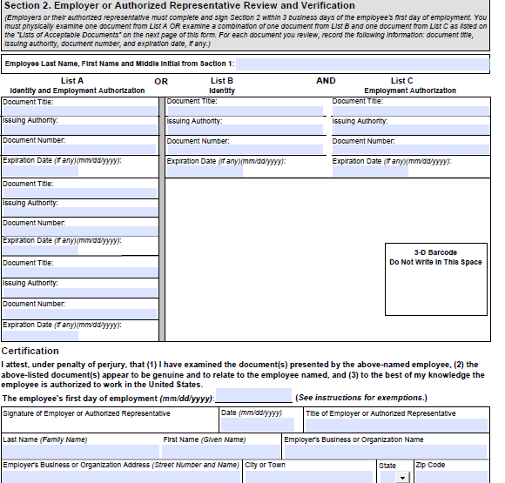
PSW: I-9 Employment Eligibility Verification
Section 2 (page 2):
Complete the following information:
PSW name
If you have a passport, fill out first 4 fields in List A column. You won’t need to fill out List B or List C.
  If no passport, fill out List B column with your Driver’s License information AND List C column with your Social Security #. See example to the right for how to fill out.
  Note: If you do not have either of these documents, reference page 3 of the I-9 form for more information on authorized forms of ID
PSW’s first date of employment.
Employer signature and demographic information.
  Notes:
  Write “household employer” in fields “Title of Employer” and “Employer’s Business or Organization Name”
  Write in Employer’s home address in field “Employer’s Business or Organization Address”
  Sign and date where yellow highlighted
Section 3 at very bottom of I-9 is for rehires only - do not fill out that box/area.
1
US Passport
Oregon driver’s license
Social Security Card
U.S. State Dept
DMV
Soc. Security Admin
2
######
#####
###-##-####
MM-DD-YYYY
MM-DD-YYYY
N/A
3
Household Employer
4
Household Employer

Slide 16
PSW: Required form #3
Federal Form W-4 Employees Witholding Allowance Certificate
# of pages: 1
Who needs to sign?: PSW only
What am I signing?: All PSW’s will need to complete a new W-4 withholding form for every Individual/Employer they work for. Use the attached worksheet to assist in determining the withholding allowances.
If you are filing as exempt, you should write “EXEMPT” in line 7 and leave lines 5 and 6 blank.
Alternatively, if you are claiming allowances, you should write the number of allowances in line 5 and leave line 7 blank.
If you want to claim an additional dollar amount to be withheld for taxes in addition to the amount that was claimed in box 5, please write the dollar amount in box 6.
Make sure to write in the Employer’s name and address if not already filled out (next to orange arrow).
NOTE: This W-4 form is used for Federal and State Tax calculations.

Slide 17
NEXT STEPS
Where to send completed forms
Where to get more help

Slide 18
Where are completed forms sent?
Completed forms can be submitted using one of the following options:
Fax: Fill out, sign and scan all required forms and Fax to PPL’s secure fax line:
    844-399-6593
Email: PPLORFMAS@pcgus.com Fill out, sign and scan all required forms into a PDF format. We recommend you sending your forms via a secure email. If you do not have access to one, you can call PPL customer service to request a secure email link be sent to your email address.
Mail: Fill out, sign, and send the packet to PPL at:
Public Partnerships – OR FMAS
PO Box 50040
Phoenix, AZ 85076
PPL will process submitted paperwork within 4 business days of receipt.

Slide 19
Where can we go to learn more and get help?
PPL has a dedicated Call Center for OR FMAS program callers.
Monday-Friday, 8:00 AM to 5:00 PM Pacific Time
(excluding State and Federal holidays)
Toll-free number – English | 1-888-419-7705
Toll-free number – Spanish | 1-888-419-7720
Toll-free number – Russian | 1-888-419-7734
TTY | 1-800-360-5899
Fax number (e-fax) | 1-844-399-6593
Customer Service e-mail address for general questions | PPLORFMAS-CS@pcgus.com
Enrollment Paperwork Submission e-mail address | PPLORFMAS@pcgus.com

Slide 20
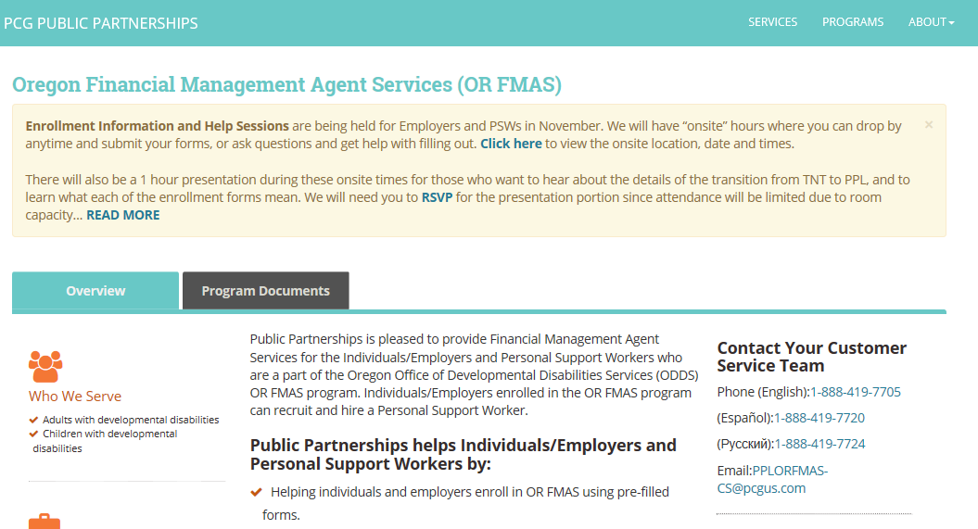
Where can we go to learn more and get help?
PPL has a dedicated OR FMAS website where BetterOnline training materials will be available: http://publicpartnerships.com/programs/oregon/fmas/index.html

