Slide 1
NJ Division of Developmental Disabilities (DDD)
Self Directed Option Program
VenDor FIscal employEr Agent Model
“PPL Talks to Vendors” Webinar
^{February 23, 2021}
Notes:
Good day and welcome to the Support Coordinator Connections. We are very happy that you could all join us. We would like to start off by thanking all the SC for your commitment to our participants during this time in helping them get their employees enrolled to bridge the gap in care during the pandemic. Thank you.

Slide 2

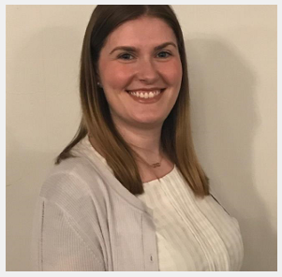

INTRODUCTIONS OF PPL NJ DDD ACCOUNT MANAGEMENT
Kimberly Smith
Account Manager
Danielle Sabestinas
Director of Client Management and Information & Assistance
Cassidy Braun
Account Specialist
Notes:
Know that we are dedicated as a company to making self-direction easier and more accessible to the individuals that we serve. It is because of this reason that we offer these webinars. As I am sure you have all experienced, things tend to change frequently as the world around us changes and we are here to help guide all of you through these changes. Today we will be reviewing all the topics listed and we will have plenty of time at the end too answer the questions you have submitted.

Slide 3

WELCOME TO
“PPL TALKS TO…VENDORS”
Agenda
Introductions
2021 Vendor Payroll Schedule
Vendor Newsletter
BetterOnlineTM Portal Registration
E-Invoice Management
Future Webinars
Contacts
Q&A
Notes:
Know that we are dedicated as a company to making self-direction easier and more accessible to the individuals that we serve. It is because of this reason that we offer these webinars. As I am sure you have all experienced, things tend to change frequently as the world around us changes and we are here to help guide all of you through these changes. Today we will be reviewing all the topics listed and we will have plenty of time at the end too answer the questions you have submitted.

Slide 4
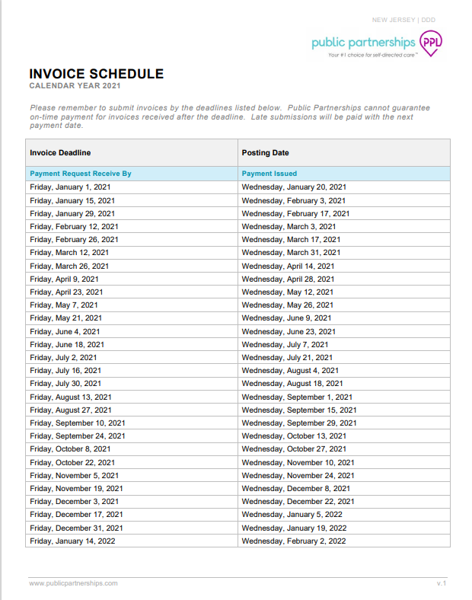
NEW 2021 VENDOR
PAYROLL SCHEDULE
NEW
Please note that the Invoice date has changed from Wednesdays to Fridays
https://www.publicpartnerships.com/media/taop1mvd/nj-ddd-invoice-schedule-2021.pdf

Slide 5
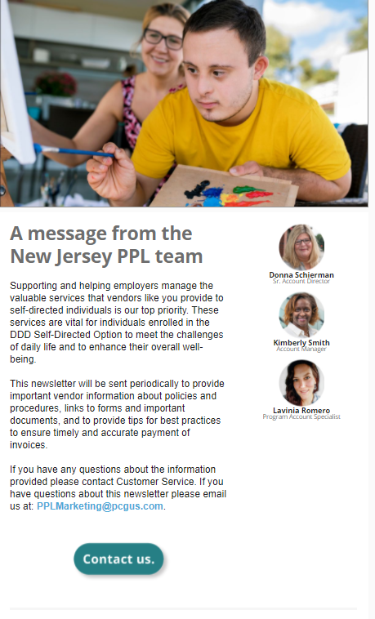
2021 VENDOR NEWSLETTER
NEW
A Vendor Newsletter was distributed on 2/12/2021 to advise of a change to the vendor payroll schedule

Slide 6
BetterOnlineTM Portal

Slide 7

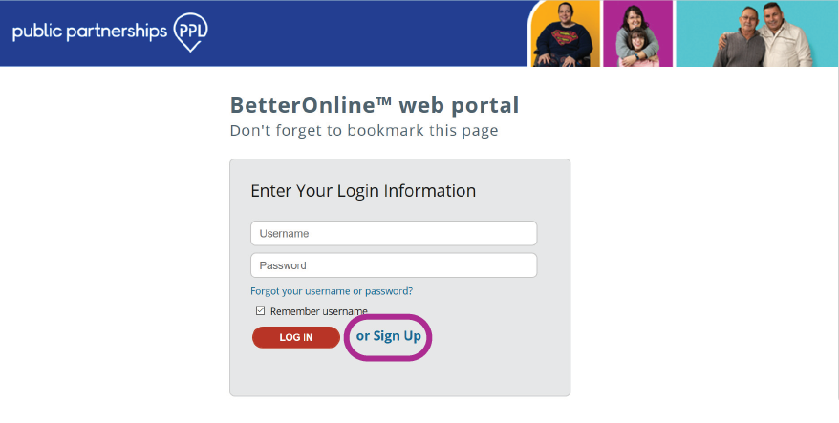
BetterOnline PORTAL
Vendor Registration Instructions
01 - Open your browser.
02 - Go to: https://fms.publicpartnerships.com/PPLPortal
03 - Click on the Sign Up link

Slide 8
BetterOnline PORTAL
Vendor Registration Instructions
04 - Select New Jersey from State dropdown menu.
05 - Select NJ DDD from the Program dropdown menu
06 - Select Self-Directed Employee or Vendor from the Role dropdown menu and click Next

Slide 9
BetterOnline PORTAL
Vendor Registration Instructions
07 - Enter Provider ID in the corresponding field. This is the PPL number assigned to your organization. It begins with PONJD and is followed by 6 digits.
08 - Enter the EIN in the Provider nine-digit Social Security Number or EIN field.
09 - Enter Provider Last Name in the corresponding
field and click Next →

Slide 10
BetterOnline PORTAL
Vendor Registration Instructions
10 - The Vendor name will automatically populate the First Name and Last Name fields.
11 - Enter a Username.
12 - Enter an Email Address.
13 - Enter a Password.
14 - Re-enter your Password for confirmation.

Slide 11
BetterOnline PORTAL
Vendor Registration Instructions
15 - Select three security questions and enter an answer it each corresponding field.
16 - Click Submit.
17 - Your Username has been created. Click on the link to login.

Slide 12
BetterOnline PORTAL
Vendor Registration Instructions
18 - Enter your Username and Password. The click on the LOG IN button.
19 - Read and Accept the PPL Terms of Use Agreement.

Slide 13
Congratulations! You are now
ready to use BetterOnline™.
https://www.publicpartnerships.com/media/gjbdiedn/nj_ddd_betteronline-vendor-registration_creative-v1.pdf

Slide 14
E-voice management

Slide 15
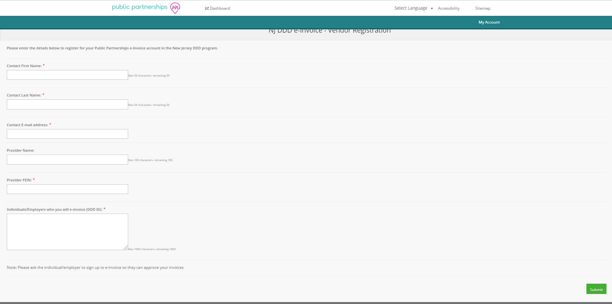
E-INVOICE MANAGEMENT
REGISTER FOR AN ID & PASSWORD
In order to access the e-invoice platform, you must first register for an ID and Password by completing the registration form here: https://account.publicpartnerships.com/NJ-DDD-Vendor-Registration
Once you access this form, complete the required information. You will receive your ID and password in less than 2 business days.

Slide 16
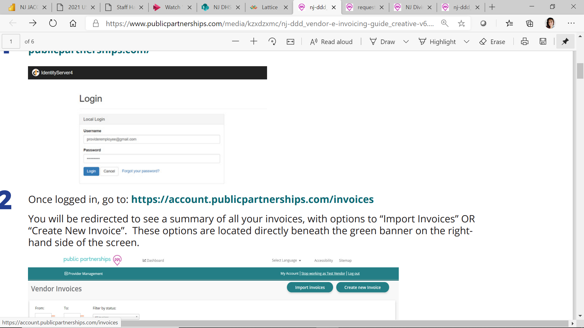
E-INVOICE MANAGEMENT
Section 1: How to Create and Submit an e-Invoice
Log into the e-Invoice web portal using your username and password:
https://account. publicpartnerships.com

Slide 17
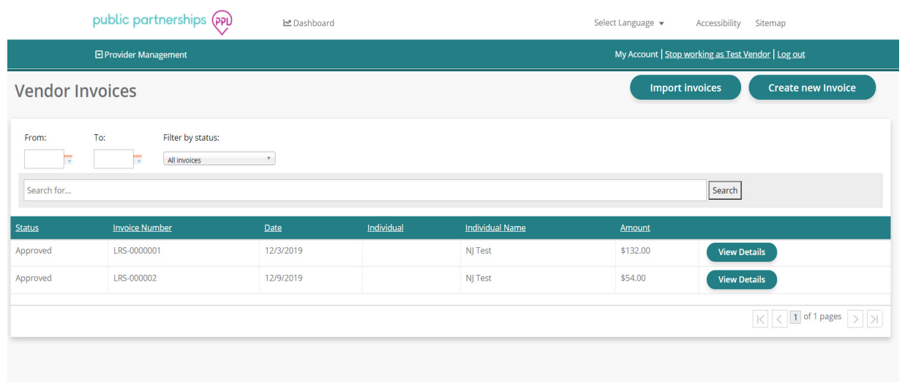
E-INVOICE MANAGEMENT
Section 1: How to Create and Submit an e-Invoice
Once logged in, go to: https://account.publicpartnerships.com/invoices You will be redirected to see a summary of all your invoices, with options to “Import Invoices” OR “Create New Invoice”. These options are located directly beneath the green banner on the righthand side of the screen.

Slide 18
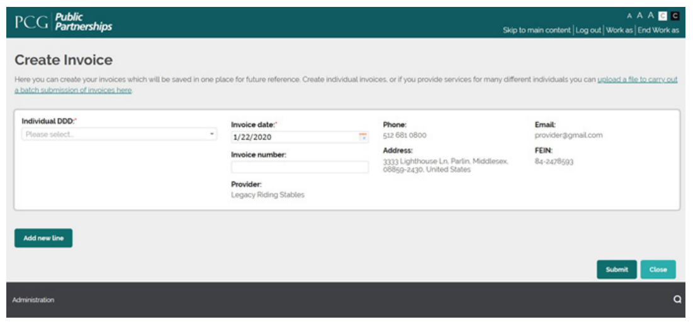
E-INVOICE MANAGEMENT
Section 1: How to Create and Submit an e-Invoice
Click on the Create New Invoice button. You will be directed to the Create Invoice screen. From here you can create an invoice for all the individuals that you provide services to.

Slide 19
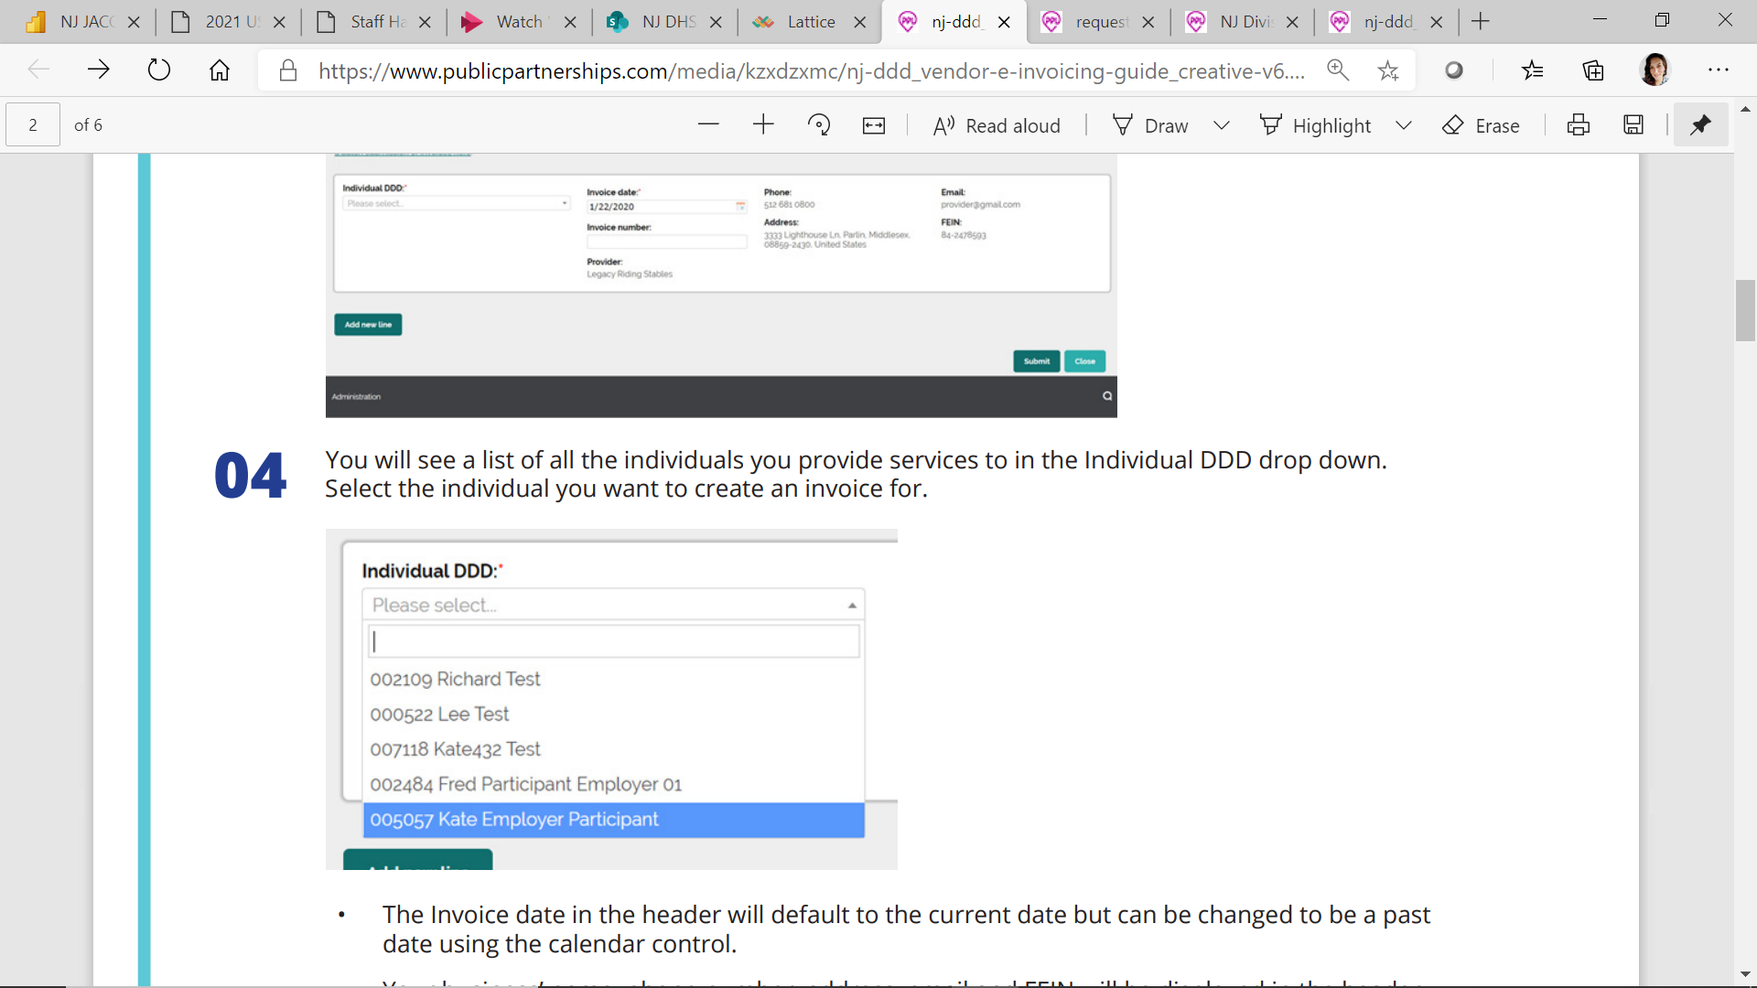
E-INVOICE MANAGEMENT
Section 1: How to Create and Submit an e-Invoice
You will see a list of all the individuals you provide services to in the Individual DDD drop down. Select the individual you want to create an invoice for.
The Invoice date in the header will default to the current date but can be changed to be a past date using the calendar control.
Your business’ name, phone number, address, email and FEIN will be displayed in the header of the invoice and are pulled through from the details provided in your account.

Slide 20
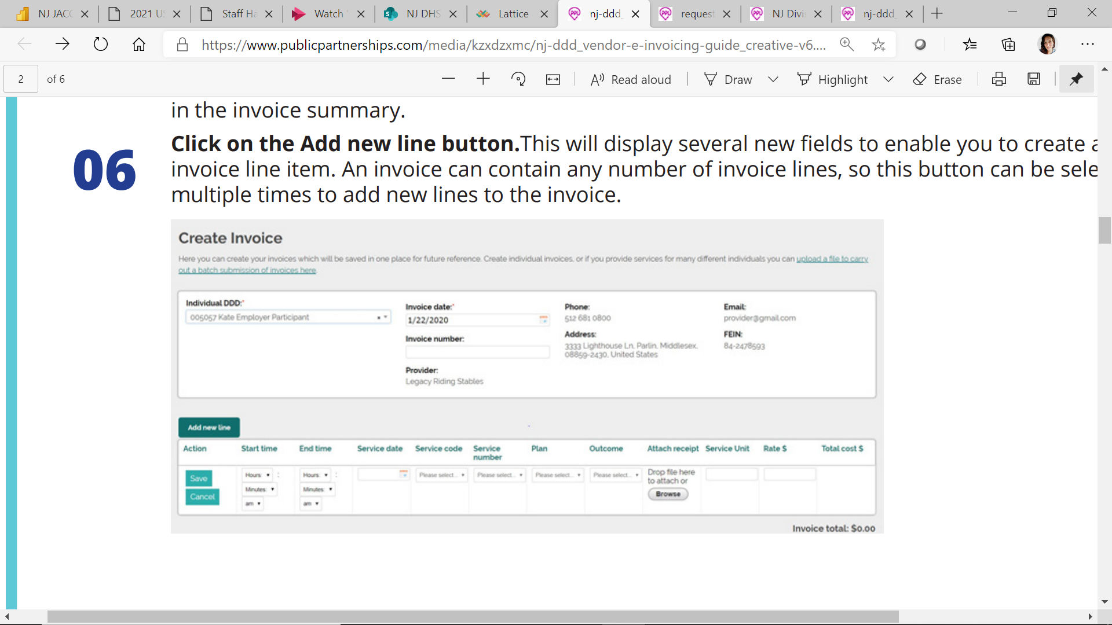
E-INVOICE MANAGEMENT
Section 1: How to Create and Submit an e-Invoice
Enter an Invoice number. The number can be a combination of characters and numbers, but it is recommended you create something that is meaningful and incremental. If you leave this field blank, the system will automatically generate an invoice number for you, and this will be displayed in the invoice summary.
Click on the Add new line button. This will display several new fields to enable you to create a new invoice line item. An invoice can contain any number of invoice lines, so this button can be selected multiple times to add new lines to the invoice.

Slide 21
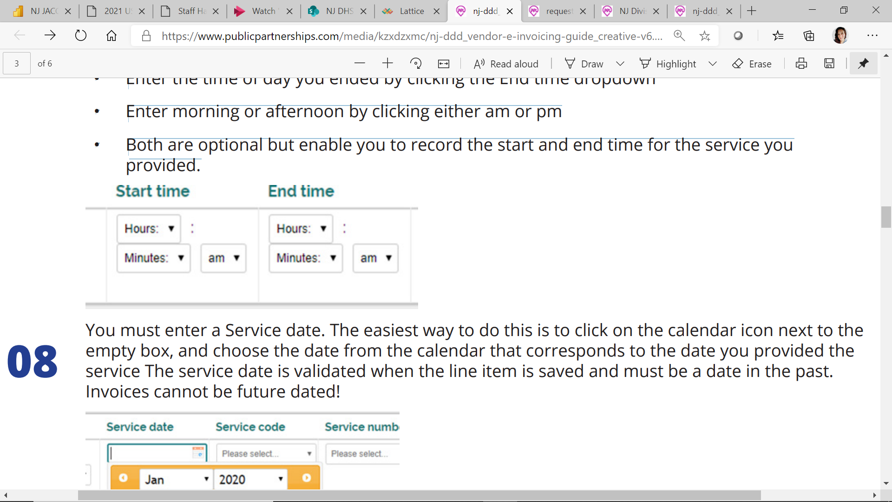
E-INVOICE MANAGEMENT
Section 1: How to Create and Submit an e-Invoice
• Enter the Hours and Minutes you provided the service
• Enter the time of day you started by clicking the Start time dropdown
• Enter the time of day you ended by clicking the End time dropdown
• Enter morning or afternoon by clicking either am or pm
• Both are optional but enable you to record the start and end time for the service you provided.

Slide 22
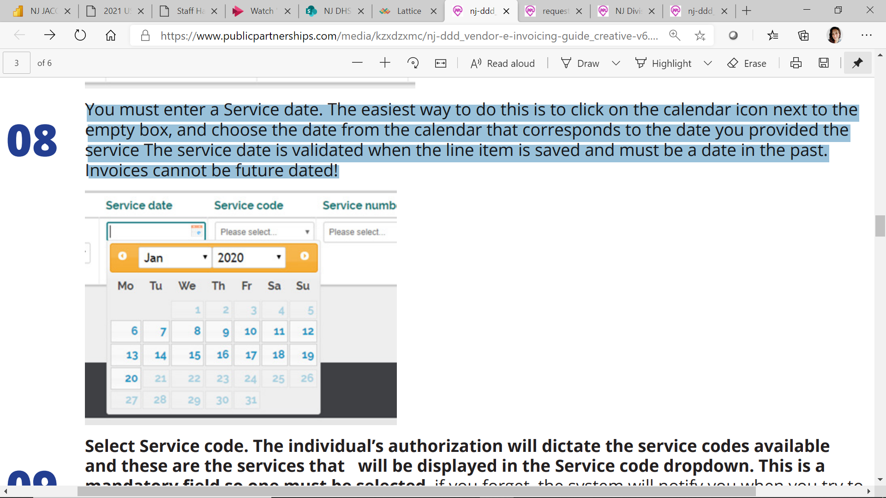
E-INVOICE MANAGEMENT
Section 1: How to Create and Submit an e-Invoice
You must enter a Service date. The easiest way to do this is to click on the calendar icon next to the empty box and choose the date from the calendar that corresponds to the date you provided the service. The service date is validated when the line item is saved and must be a date in the past.
Invoices cannot be future dated!

Slide 23
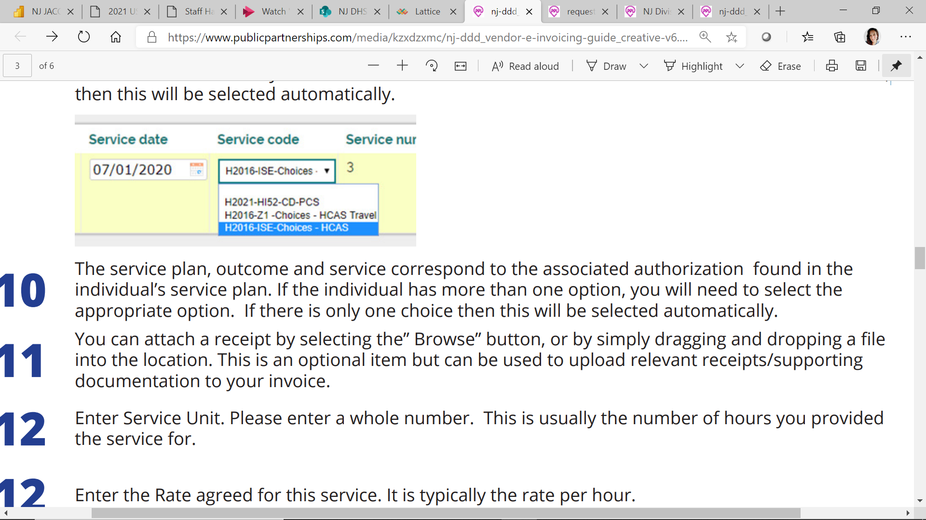
E-INVOICE MANAGEMENT
Section 1: How to Create and
Submit an e-Invoice
Select Service code: The individual’s authorization will dictate the service codes available and these are the services that will be displayed in the Service code dropdown. This is a mandatory field so one must be selected. If you forget, the system will notify you when you try to save the line item.
If only one service code has been allocated for services to the selected individual, then this will be selected automatically.

Slide 24
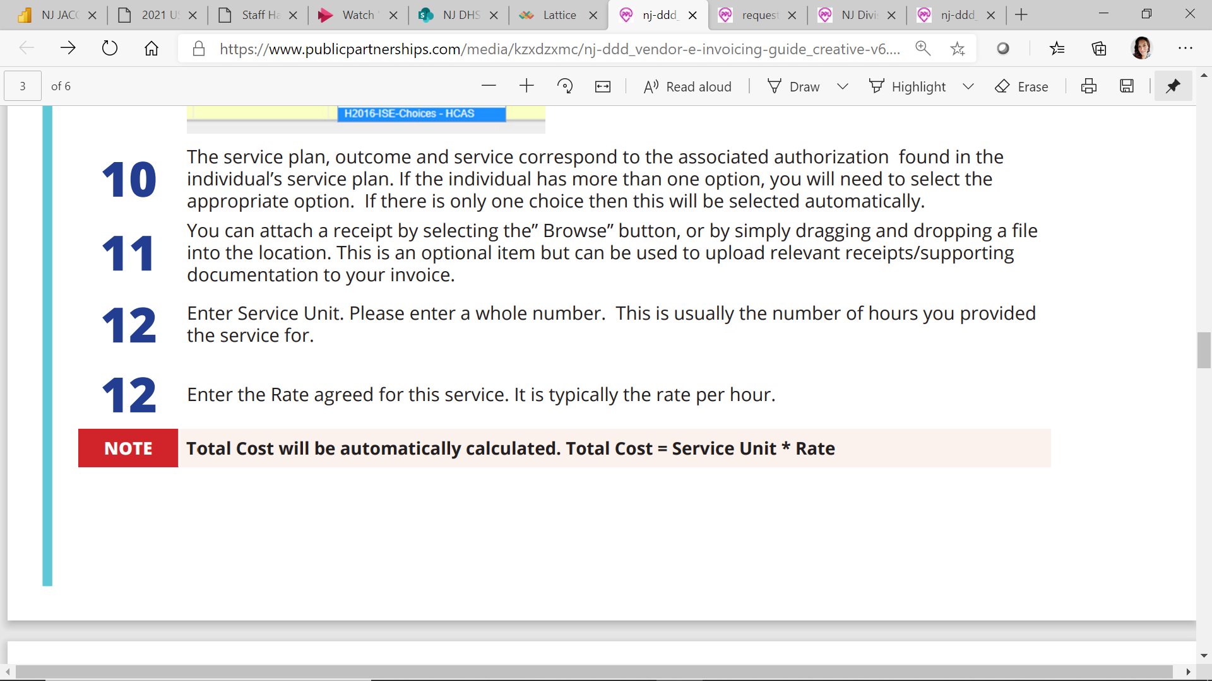
E-INVOICE MANAGEMENT
Section 1: How to Create and Submit an e-Invoice
The service plan, outcome and service correspond to the associated authorization found in the individual’s service plan. If the individual has more than one option, you will need to select the appropriate option. If there is only one choice than this will be selected automatically.
You can attach a receipt by selecting the” Browse” button, or by simply dragging and dropping a file into the location. This is an optional item but can be used to upload relevant receipts/supporting documentation to your invoice.
Enter Service Unit. Please enter a whole number. This is usually the number of hours you provided the service for.
Enter the Rate agreed for this service. It is typically the rate per hour.

Slide 25
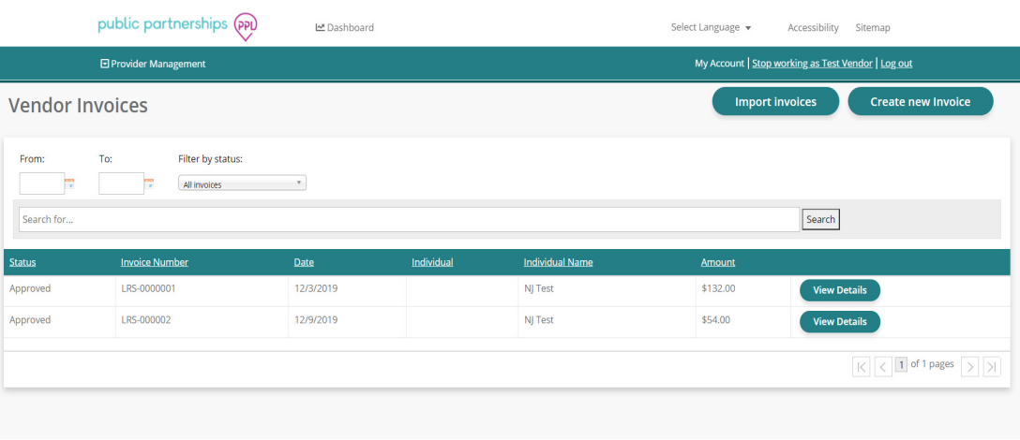
E-INVOICE MANAGEMENT
Section 1: How to Create and Submit an e-Invoice
If you want to remove the line item select Cancel, otherwise select Save to save the invoice line item.
• To add another line item to the invoice, select Add new line button.
• All line items must be individually saved before the invoice can be submitted.
When an invoice is submitted you will return to the Invoice Summary page, where it will appear with a status of Waiting Approval.

Slide 26
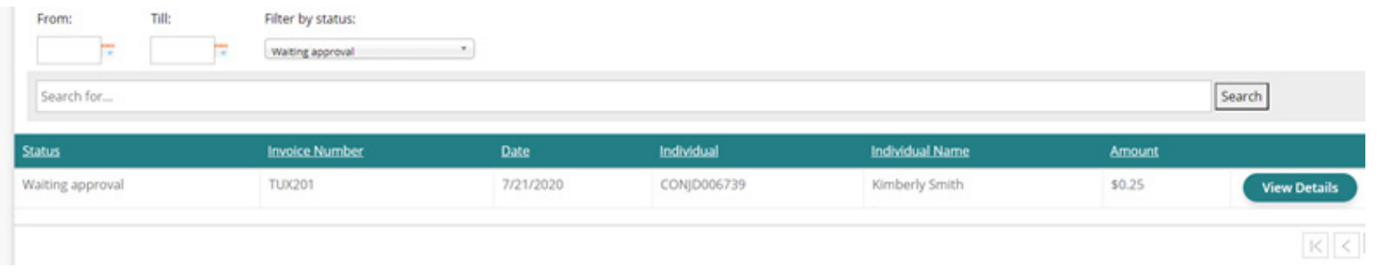
E-INVOICE MANAGEMENT
Section 2: How to Cancel a Submitted Entry
When you have submitted your invoice, it can be canceled before it has been Approved or Rejected if you realize you made a mistake while submitting the invoice. It is important to cancel and invoice before creating
a new invoice for the same pay period as duplicate invoices will automatically be rejected.
Cancelling an invoice can be done by selecting View Details button on Invoices in a “Waiting approval” status.

Slide 27
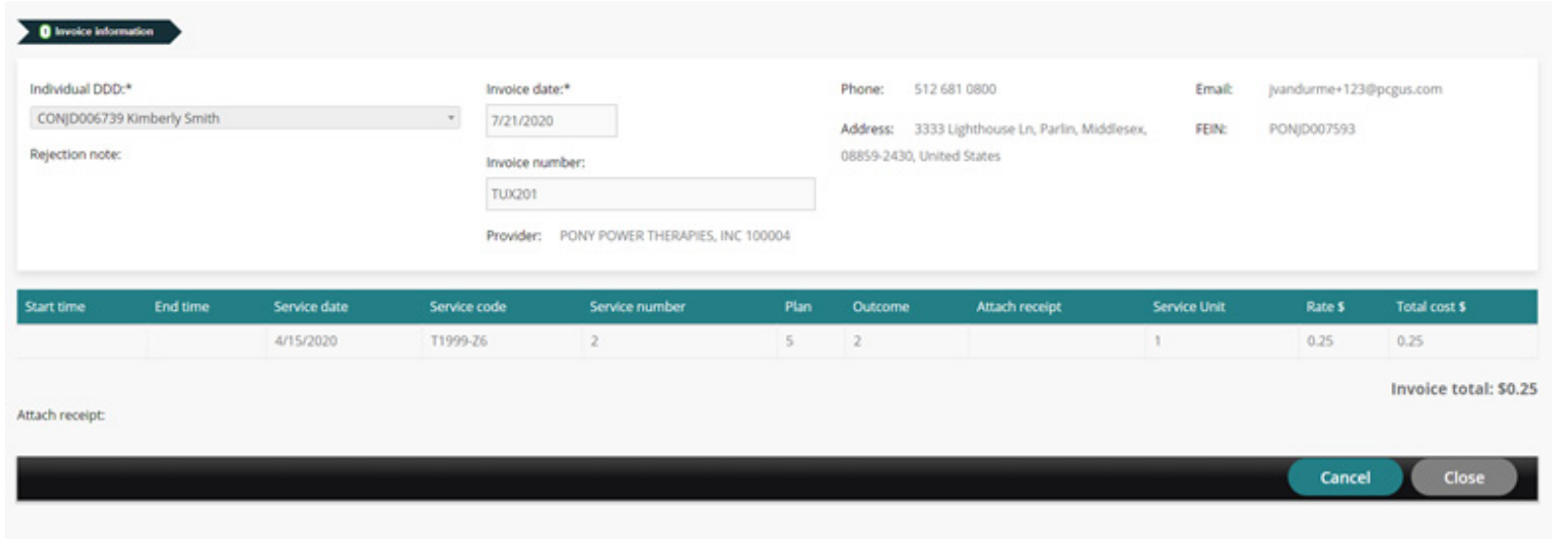
E-INVOICE MANAGEMENT
Section 2: How to Cancel a Submitted Entry
View details view. Cancel option is on the bottom right of invoice.

Slide 28
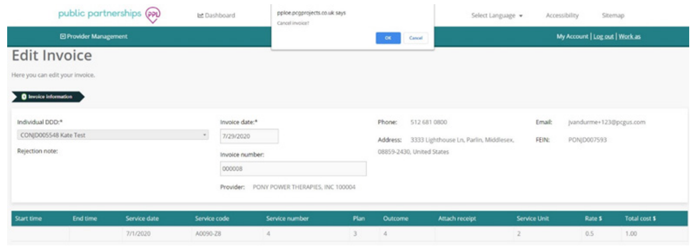
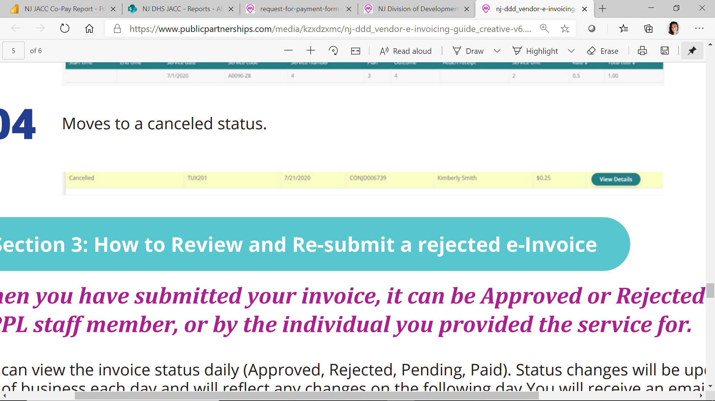
E-INVOICE MANAGEMENT
Section 2: How to Cancel a Submitted Entry
Prompts to cancel invoice.
Moves to canceled status.

Slide 29
E-INVOICE MANAGEMENT
Section 3: How to Review and Re-submit a rejected e-Invoice
When you have submitted your invoice, it can be Approved or Rejected by either a PPL staff member, or by the individual you provided the service for.
You can view the invoice status daily (Approved, Rejected, Pending, Paid).
Status changes will be updated at the end of business each day and will reflect any changes on the following day.
You will receive an email notification to advise of both Approved and Rejected invoices, and you will see the relevant status when logging into the Invoice Summary screen as can be seen above.
Rejected invoices must contain a rejection reason.

Slide 30
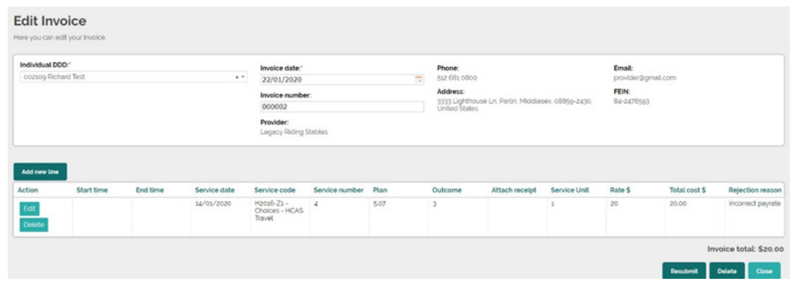
E-INVOICE MANAGEMENT
Section 3: How to Review and Re-submit a rejected e-Invoice
View rejected invoices can be viewed by selecting View details button. The rejection reason is contained in the last field of the rejected line item.

Slide 31
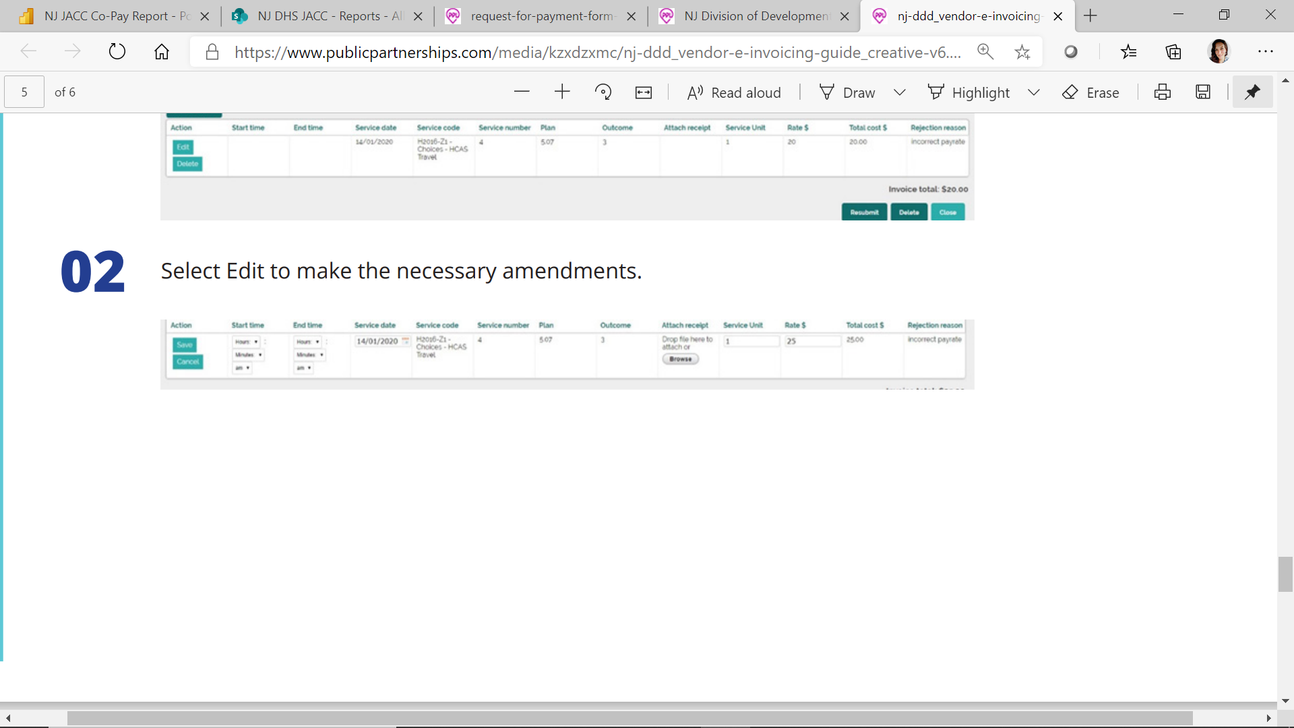
E-INVOICE MANAGEMENT
Section 3: How to Review and Re-submit a rejected e-Invoice
Select Edit to make the necessary amendments.
Select Save and Submit when you’re happy with all changes.

Slide 32
E-INVOICE MANAGEMENT
Section 3: How to Review and Re-submit a rejected e-Invoice
Once the Participant has approved your invoice, the status of the invoice will change to an approved status and will be sent to Public Partnerships for validation.
Below are the expected outcomes based on invoice validation:
  • Approved (Pending) There is something wrong with your invoice and causing it not to go into Good to Pay
  • Approved (Good to Pay) Your invoice has passed validation and is awaiting to be paid on the next scheduled payroll
  • Approved (Paid) A check has been generated for your invoice
  • Approved (Denied) Participant approved your invoice in error and asks to have it denied. Invoice was pending for a long period of time and systematically denies or was asked to be denied. (would need to be re-entered if needed)

Slide 33

Please Join Us for Upcoming
“PPL Talks to Vendors” Webinars
4th Tuesday of the Month
This series is targeted to vendors who bill self-directed services through PPL (e.g., Goods and Services), but anyone with an interest may attend any or all of the three webinars in the series (TEAMS Live events), including Support Coordinators, individuals and families.
Pre-registration is not required. To join the PPL Talks to Vendors webinar, simply click on the Join Webinar Now link below at 12:00 NOON on the date of the event.
Tuesday
March 23,
12:00 Noon:
Join Vendor Webinar Now

Slide 34

IMPORTANT PPL CONTACTS
1-844-842-5891 (English) 1-844-842-5892 (Spanish) NJDDD-CS@pcgus.com Customer Service Hours Mon - Fri 8:00am - 6:00pm EST | 1) General inquires related to PPL services a. BetterOnline Portal registration b. Login assistance or training c. Understanding timesheets, payments or Earning Statement d. Payment status e. Enrollment support and status f. Authorization details received by PPL
NJDDD-ADMIN@pcgus.com | 1) Escalations from the Divisions 2) Receives Complaint and Appeal forms
NJDDD-SC@pcgus.com | 1) Receives Referral forms only
1-844-561-5978 (fax) NJDDD@pcgus.com | 1) Receives program related documents only a. Enrollment forms b. Rate change forms c. Verification of employment d. Vender invoices
NJDDD-training@pcgus.com | 1) Inquiries related to training requirements
1-844-231-4793 (fax) | 1) Receives paper timesheets

Slide 35
Questions?
Speak Up!

Slide 36

Mission:
Transform more lives by making
self-directed home care easier for all.
You = We =
=

Slide 37
The content of this presentation is proprietary and confidential information of Public Partnerships LLC (“PPL”). It is not intended to be distributed to any third party without the written consent of PPL.

