Slide 1
Registering A New PDP Provider
7/13/16

Slide 2
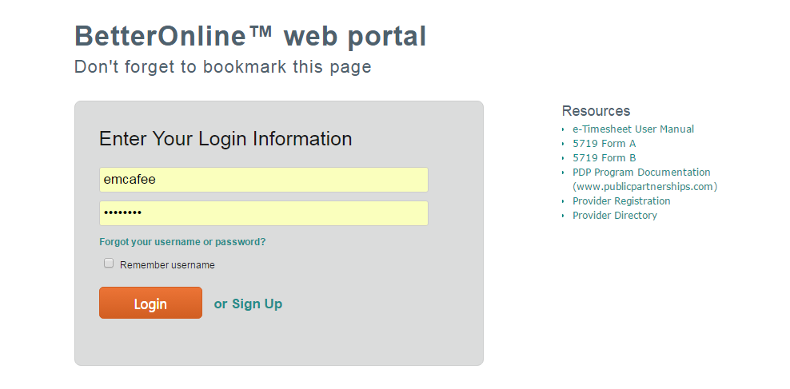
Click ‘Provider Registration’

Slide 3
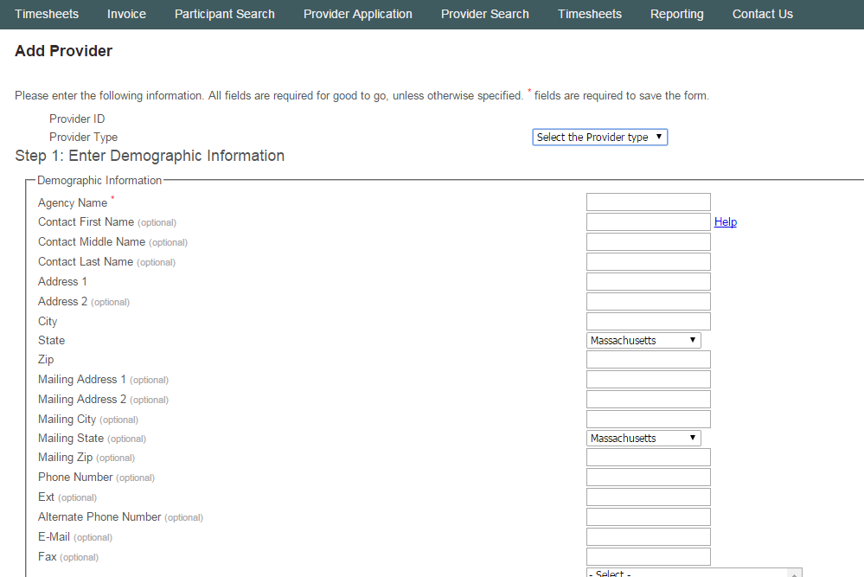
Select provider type and fill in demographic information. Click ‘Next’ at the bottom of the page

Slide 4
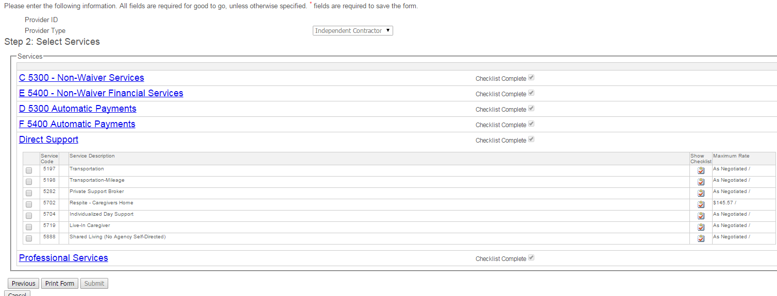
Select the services which the provider will provide and click ‘print form’

Slide 5
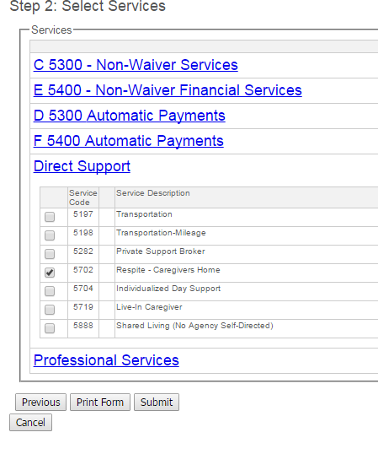
Ensure that you click ‘submit’ after the packet is printed.

Slide 6
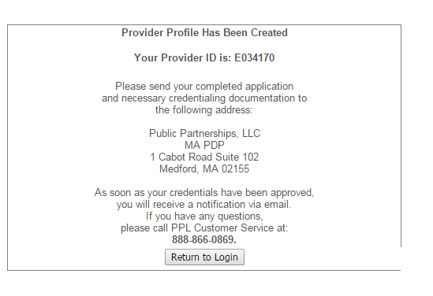

Slide 7
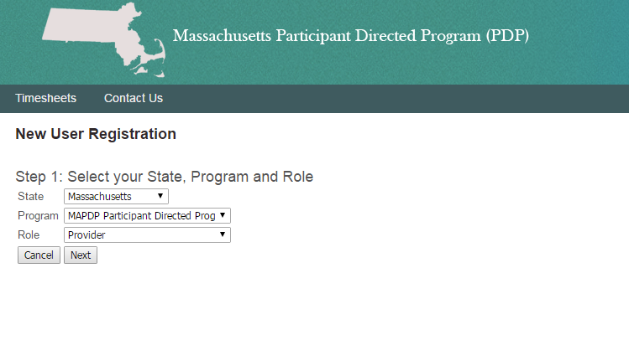
- Select ‘Massachusetts’, ‘MA PDP Program’ and ‘Provider’.
- Click ‘Next.

Slide 8
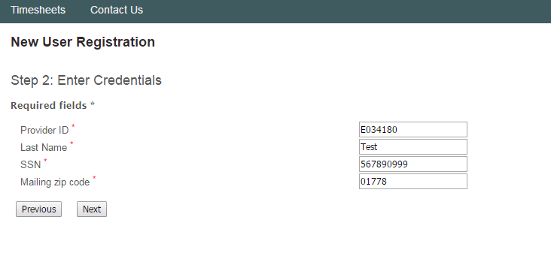
Enter new user credentials

Slide 9
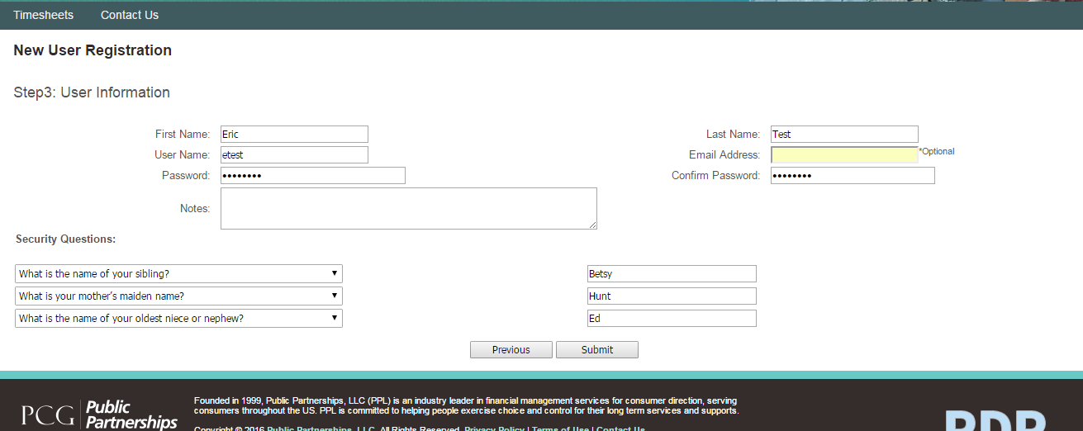
Create username and password
Create security questions

Slide 10
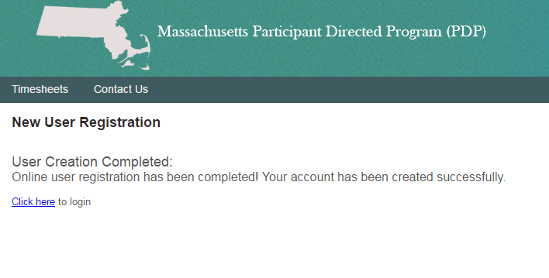
Success!

Slide 11
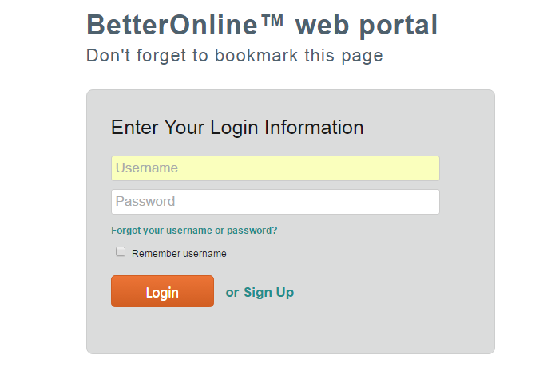
Login with your username and password

Slide 12
Click ‘Create Timesheet’

Slide 13
Select the participant for which you want to submit the timesheet

Slide 14
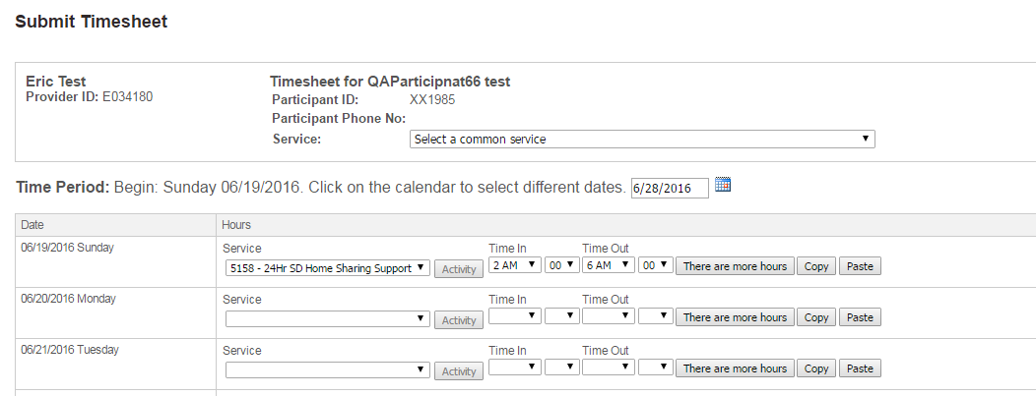
- Complete the timesheet with service code, time in and time out
- Click ‘Next’ at the bottom of the screen

Slide 15
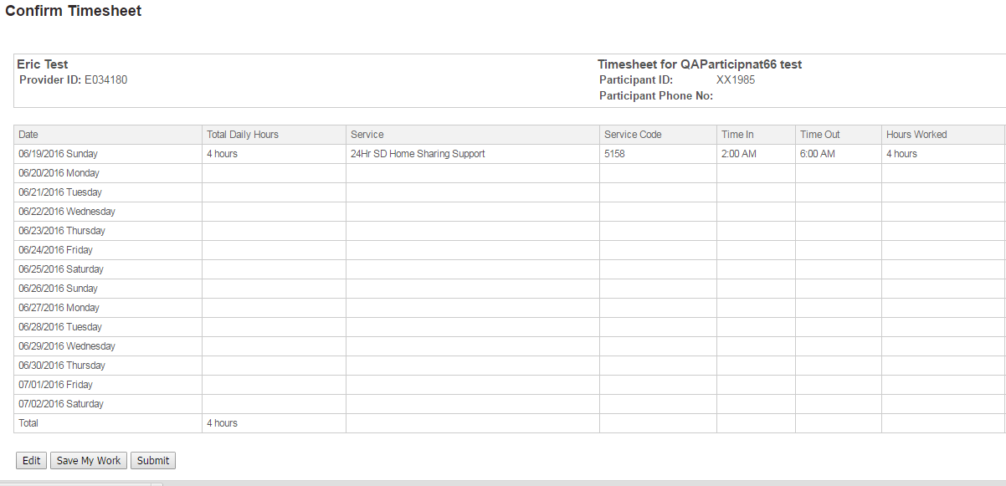
- Click ‘Submit’ to submit the timesheet.
- Click ‘Save My Work’ to save the timesheet and submit at a later date

Slide 16
Variations from the norm
MEA Registration Differences
Extract credentials
Employee packet on www.publicpartnerships.com
Must be ‘employee’ provider type
Different provider types
No credentialing for participant
No CORI for agencies
Existing provider edits
Adding services
One provider, two provider types
Email PPL to obtain new username and password

