Slide 1
NJ Division of Developmental Disabilities (DDD)
Self Directed Option Program
VenDor FIscal employEr Agent Model
PPL Talks to…Support Coordinators
Webinar Series
^{January 20, 2021}
Notes:
Good day and welcome to the Support Coordinator Connections. We are very happy that you could all join us. We would like to start off by thanking all the SC for your commitment to our participants during this time in helping them get their employees enrolled to bridge the gap in care during the pandemic. Thank you.

Slide 2

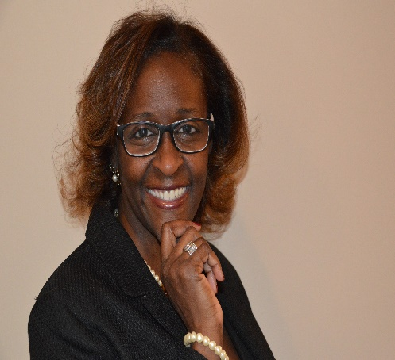

Introductions of PPL NJ DDD Account Management
Lavinia Romero
Account Specialist
Kimberly Smith
Account Manager
Donna Schierman
Sr. Account Director
Notes:
Know that we are dedicated as a company to making self-direction easier and more accessible to the individuals that we serve. It is because of this reason that we offer these webinars. As I am sure you have all experienced, things tend to change frequently as the world around us changes and we are here to help guide all of you through these changes. Today we will be reviewing all the topics listed and we will have plenty of time at the end too answer the questions you have submitted.

Slide 3
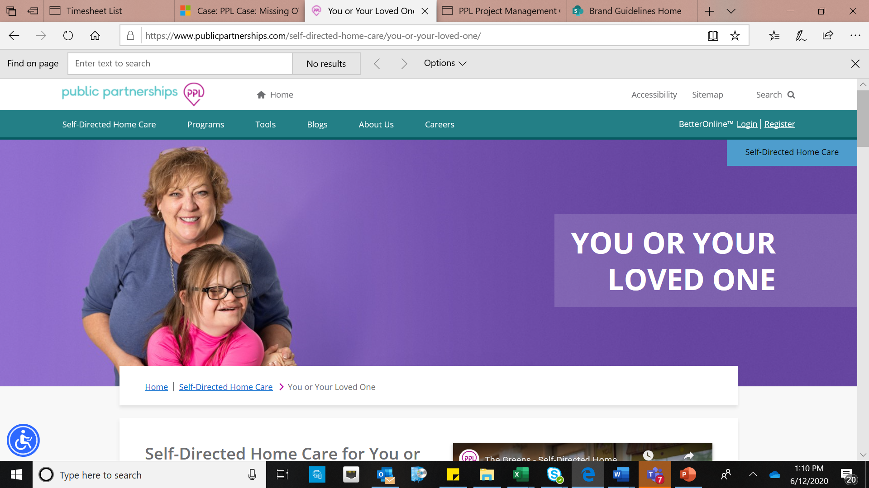
Welcome to “PPL Talks To…Support Coordinators”
Agenda
  Welcome/Introduction
  NEW! DDD Guidance for Activity Fees
  CARI Checks – Phase II
  Pre-Employment Screenings
  1/1/2021 Minimum Wage Increase
  Service Detail Reports
  NEW/Coming Soon:
    “PPL Talks to Vendors” Webinar Series
    NJ DDD Specialists – NEW Guidance
Notes:
Know that we are dedicated as a company to making self-direction easier and more accessible to the individuals that we serve. It is because of this reason that we offer these webinars. As I am sure you have all experienced, things tend to change frequently as the world around us changes and we are here to help guide all of you through these changes. Today we will be reviewing all the topics listed and we will have plenty of time at the end too answer the questions you have submitted.

Slide 4
DDD Guidance for Activity Fees
General Information
Requests for Activity Fee reimbursement must be submitted to Public Partnerships using a Request for Payment form.
Requests for Activity Fee reimbursements are processed with service code T1999HI22.
Activities should be:
  admissions to various events that promote community integration, community inclusion, education and socialization.
  Activities must be available to the general public.
Individual activity costs should be reasonable and customary.

Slide 5
DDD Guidance for Activity Fees
Annual Allowance
The annual allowance for activity fees is up to $1,000.00.
Rarely, will the costs of activities amount to exactly $1,000.00 for plan year.
  Example 1: Admission to the Liberty Science Center is estimated to cost $25.00 per person and the Service lists the unit as $60.00- once the $50.00 receipt is submitted for payment, the remaining $10.00 is no longer available for use.
  Example 2: Admission to the movies is estimated to cost $25 per person and the Service lists Unit at $1,000 – once the $50 receipt is submitted for payment, the remaining $950 is no longer available for use.

Slide 6
DDD Guidance for Activity Fees
Tips to Ensure Payment
Create service authorizations that align with the individual activities as opposed to one large amount
Create service authorizations that align to the dates that those fees will be expended; e.g., $50 per month for activity fees as opposed to $600 annually
Copies of receipts must be submitted together with the Request for Payment
Total of receipts submitted should be the same as the total payment requested – do not round up or down
Payments are made based on units of service authorized in the plan. For example:
  10 units at $50 per unit prior authorized
  Vendor submits Request for Payment for 1 unit and submits a receipt for $38.50
  Payment is issued for $38.50 and $11.50 is no longer available because that 1 unit has now been expended

Slide 7
CARI Checks – Phase II: Reminder
Phase I covered prospective employees and required CARI checks for anyone hired on or after July 16th 2018.
Phase II requires CARI checks of all existing employees, including all self-directed employees (SDEs) and all support coordination agency staff.
Provider agencies, support coordination agencies, and fiscal intermediaries should have begun Phase II by October 15th 2020 and should have a record of a completed CARI check on file for every employee/SDE by December 31st 2020.
Source: NJ DDD COVID 19 Webinar: 10/15/2020

Slide 8
CARI Checks – Phase II
SDEs complete the online CARI application through an email link. ONLY PPL can send this link to a SDE
    Employee/SDEs link expires after two weeks.
    SDEs should monitor their email to receive the link
    SDEs should reference the CARI Instructions that were included in their enrollment packet. Those instructions can be located here on the PPL NJ DDD website
    https://www.publicpartnerships.com/media/hv0fqb3n/cari-notice.pdf

Slide 9

SDE Pre-Employment Screenings: Reminder
At the onset of the pandemic, timeframes were extended for some mandated pre-employment screenings for self-directed employees (SDEs). Those extensions are still in place; however, all SDEs are required to complete all pre-employment screenings within the extended timeframe.
Mandatory pre-employment screenings with temporarily extended timeframes are fingerprinting, drug testing, and CARI check application.

Slide 10
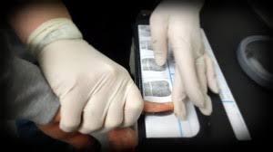
SDE Pre-Employment Screenings: Reminder
Beginning January 1, 2021, SDEs who have not completed fingerprinting, drug testing and CARI check application within the 120-day grace period from their date of hire will have their employment status and payments suspended.
Once all screenings have been completed, payments will be authorized to resume as of the date of screening completion.
Back pay will not be issued to SDEs for the period of time in which employment status was suspended.

Slide 11

Minimum Wage Increase: Self Directed Employees (SDE)
Reminder
On January 1, 2021, pursuant to New Jersey’s Minimum Wage Law, the statewide minimum wage in New Jersey increased from $11 to $12 per hour
Self-directed employees (SDE) did not receive an automatic increase because SDE wages are privately negotiated. An individual/family wishing to increase an SDE’s hourly wage should reach out to their support coordinator to discuss.

Slide 12
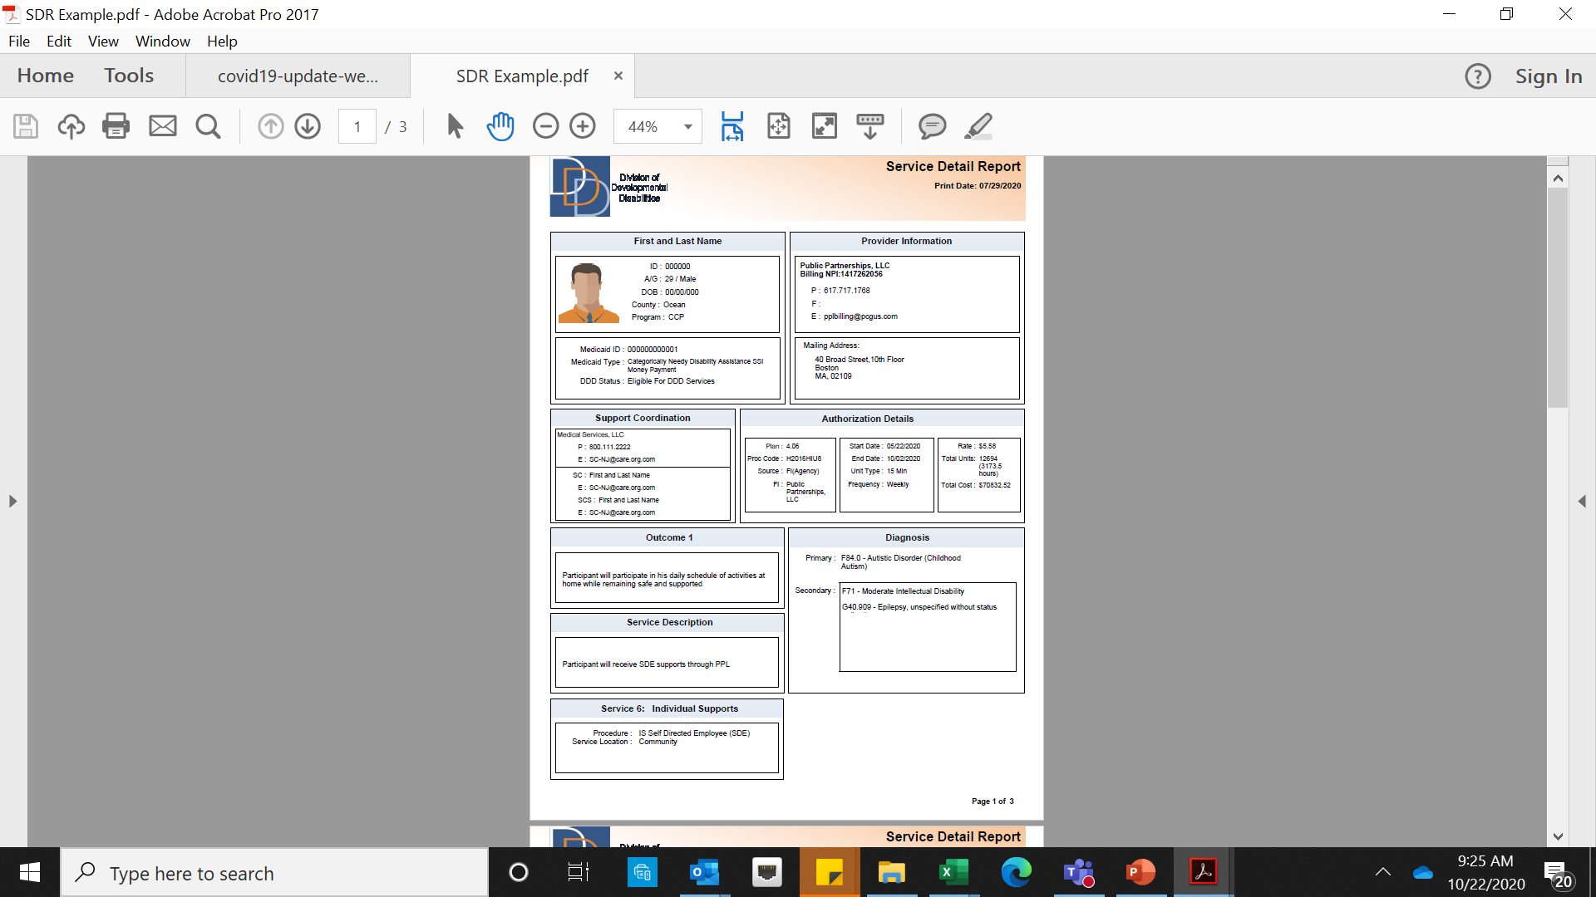
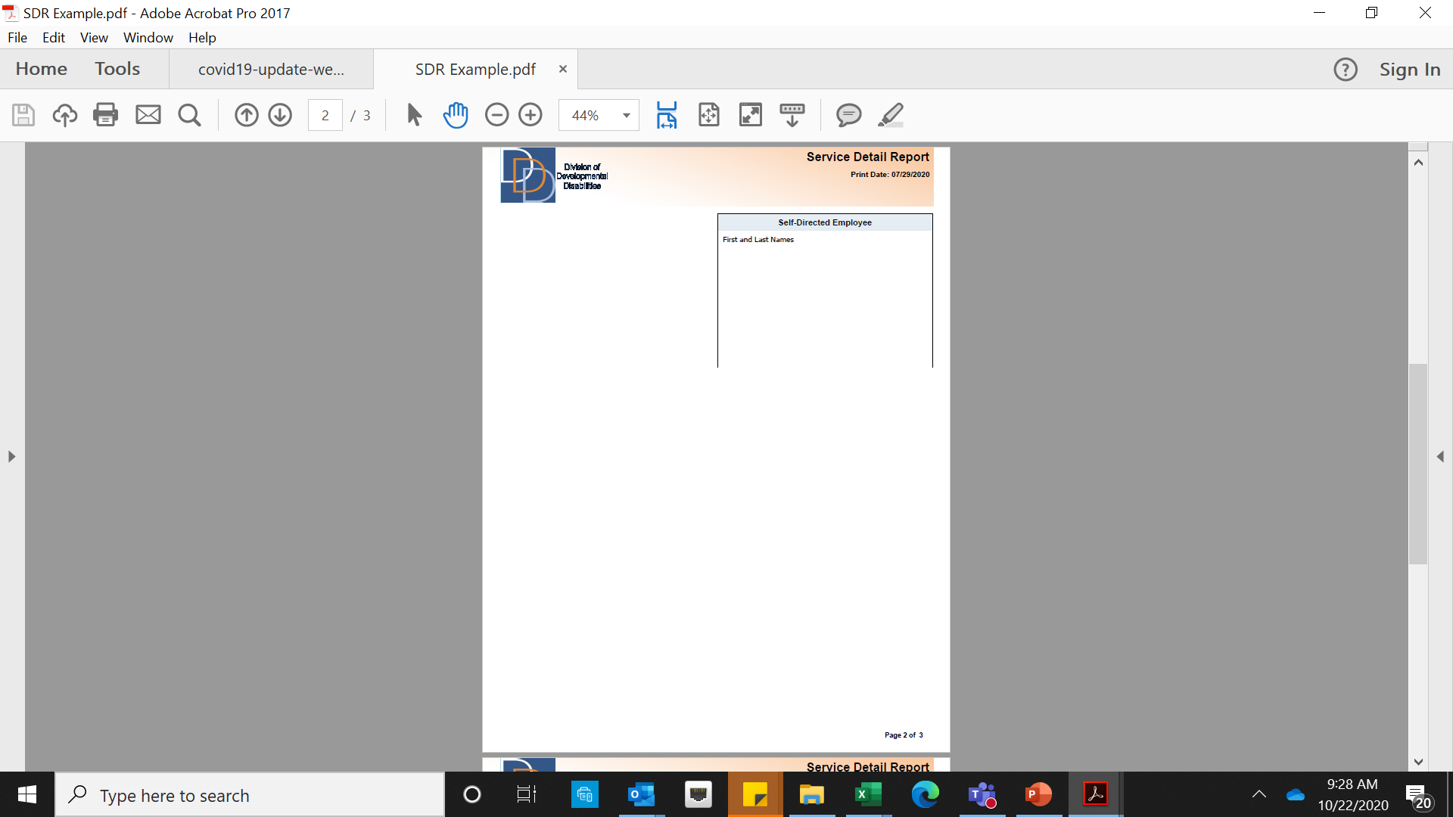
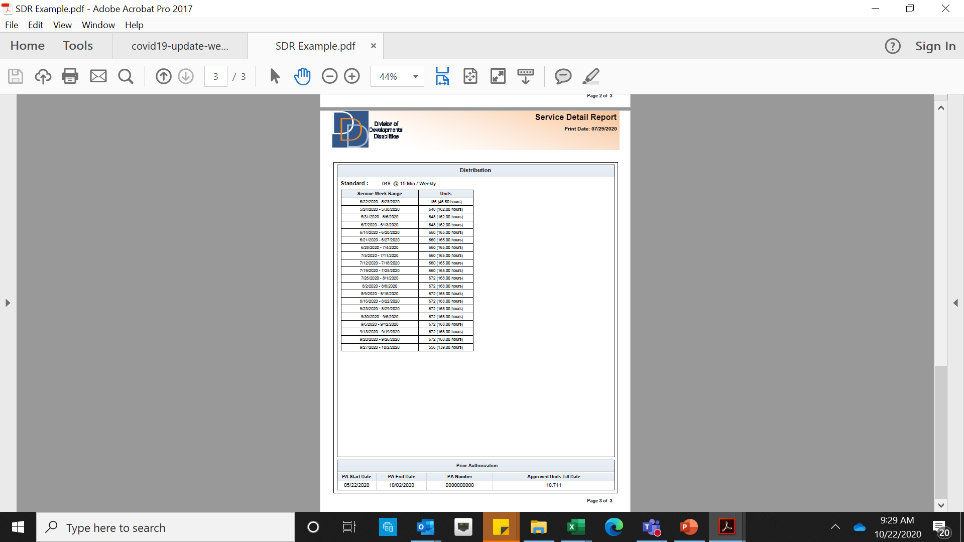
Service Detail Report (SDR): Reminder
Support Coordinators need to ensure that community vendors (Goods & Services, Environmental Modifications, Vehicle Modifications, Single Passenger Rate Transportation) receive an up-to-date Service Detail Report so the vendor is aware of which Fiscal Intermediary (FI) they will be billing.
Source: NJ DDD COVID 19 Webinar: 10/15/2020

Slide 13


Please Join Us for Upcoming
“PPL Talks to Support Coordinators” Webinars
Every third Wednesday
February 17th 2021 @ 10:00am
March 17th 2021 @ 10:00am
Please submit suggested topics for future webinars to: pplmarketing@pcgus.com

Slide 14

Please Join Us for Upcoming
“PPL Talks to Vendors” Webinars
4th Tuesday of the month
This series is targeted to vendors who bill self-directed services through PPL (e.g., Goods and Services), but anyone with an interest may attend any or all of the three webinars in the series (TEAMS Live events), including Support Coordinators, individuals and families.
Pre-registration is not required. To join the PPL Talks to Vendors webinar, simply click on the Join Webinar Now link below at 12:00 NOON on the date of the event.
January 26, 12:00 Noon: Join Vendor Webinar Now
February 23, 12:00 Noon: Join Vendor Webinar Now
March 23, 12:00 Noon: Join Vendor Webinar Now

Slide 15
DDD Specialist Initiative
NEW Guidance coming in February, 2021

Slide 16

Important PPL Contacts
1-844-842-5891 (English) 1-844-842-5892 (Spanish) NJDDD-CS@pcgus.com Customer Service Hours Mon - Fri 8:00am - 6:00pm EST | 1) General inquires related to PPL services a. BetterOnline Portal registration b. Login assistance or training c. Understanding timesheets, payments or Earning Statement d. Payment status e. Enrollment support and status f. Authorization details received by PPL
NJDDD-ADMIN@pcgus.com | 1) Escalations from the Divisions 2) Receives Complaint and Appeal forms
NJDDD-SC@pcgus.com | 1) Receives Referral forms only
1-844-561-5978 (fax) NJDDD@pcgus.com | 1) Receives program related documents only a. Enrollment forms b. Rate change forms c. Verification of employment d. Vender invoices
NJDDD-training@pcgus.com | 1) Inquiries related to training requirements
1-844-231-4793 (fax) | 1) Receives paper timesheets

Slide 17
Questions?
Speak Up!

Slide 18

Mission:
Transform more lives by making
self-directed home care easier for all.
You = We =
=

